Slide 1
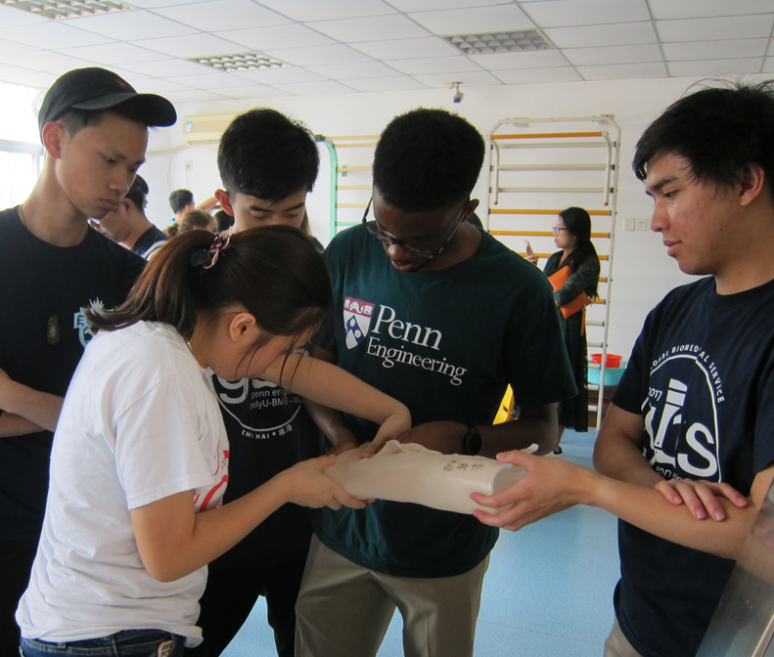
PennEngineering Rotational Development Program (PRDP)

Slide 2
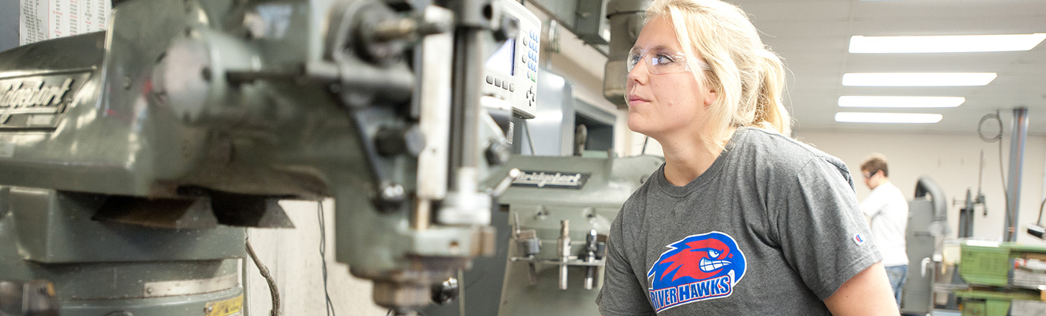
Purpose
Accelerate the participants’ professional development through targeted rotational business-critical assignments and learning opportunities which develops the workforce to continually contribute to PennEngineering’s future.

Slide 3

Candidates
Bachelor of Science in Engineering
Minimum 3.0/4.0 GPA
Held leadership roles in their academic careers
Participated in socially conscious activities
Expect to graduate during the current academic year

Slide 4
PennEngineering Rotation Development Program (PRDP) Overview
Three (3) Rotations over eighteen (18) months across the business
  Rotation 1: June – December
  Rotation 2: January - June
  Rotation 3: July - December
  Transition into regular role: January
Program Development Structure
  Mentors
  Continued Learning on various topics (i.e., Presentation skills, Financial Acumen)
  International rotations available
  Performance Evaluations
  Orientation Bootcamp
  Community Service projects
  Teambuilding Events
  Senior Management Presentations at the end of each rotation and the program
Rotation 1:
NPD Automotive (MI)
Rotation 3:
Application Engineering
(Danboro)
Engineering Role
Rotation 2:
Manufacturing Engineering
(Galway)
Example:

