Slide 1
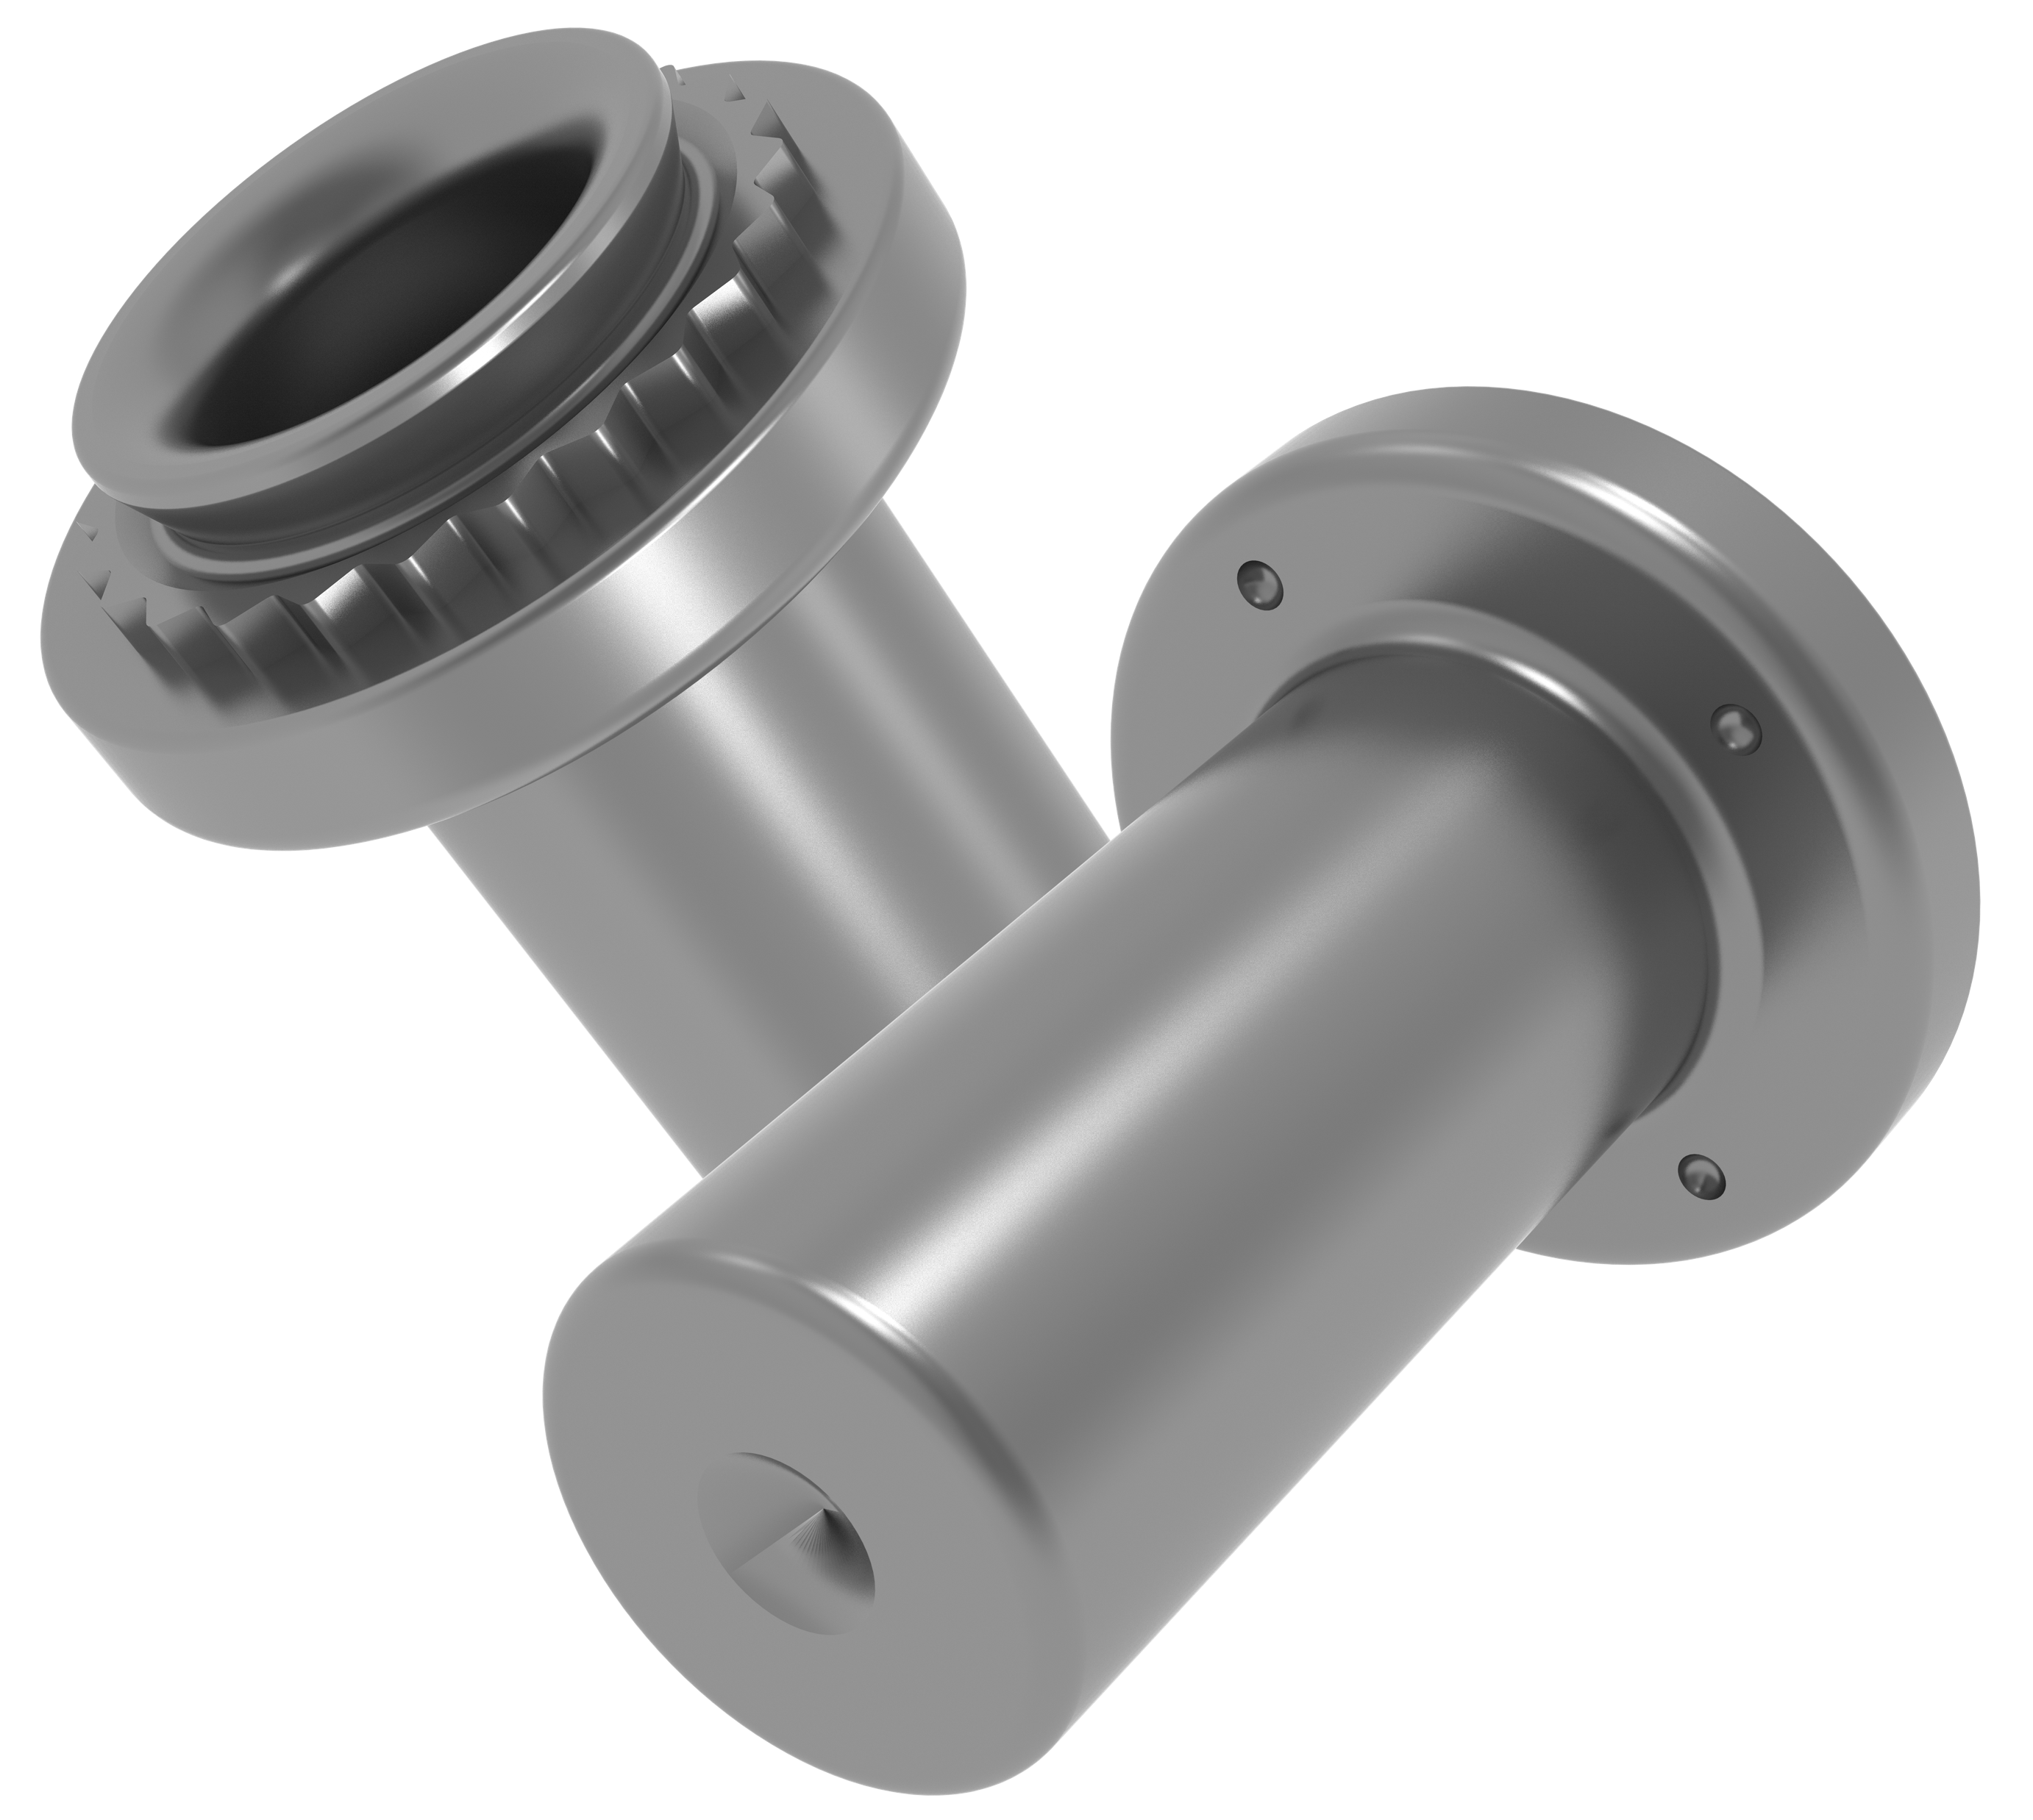
New Product Intro Package
Engineered for eMobility, high-voltage, and soft-material applications.
Clean installation. Superior performance. No compromises.
Fine Finish BF™/BFS™
Self Clinching Blind Nuts
(For internal use only, do not share externally)
2026 | PennEngineering® New Product Commercialization Team

Slide 2
Agenda
01
What Is BF™ / BFS™?
05
Sizes, Metals & Finishing
What is arcing?
Product overview & unique value proposition
Complete technical specifications
02
How It Differs
06
Target Customer List
vs. standard B™ / BS™ and industry alternatives
OEMs, ODMs & fabricators
03
Applications
07
Call to Action
Where it wins — target markets & use cases
Next steps for your team
04
Installation
Step-by-step instructions & tooling
Confidential 2

Slide 3
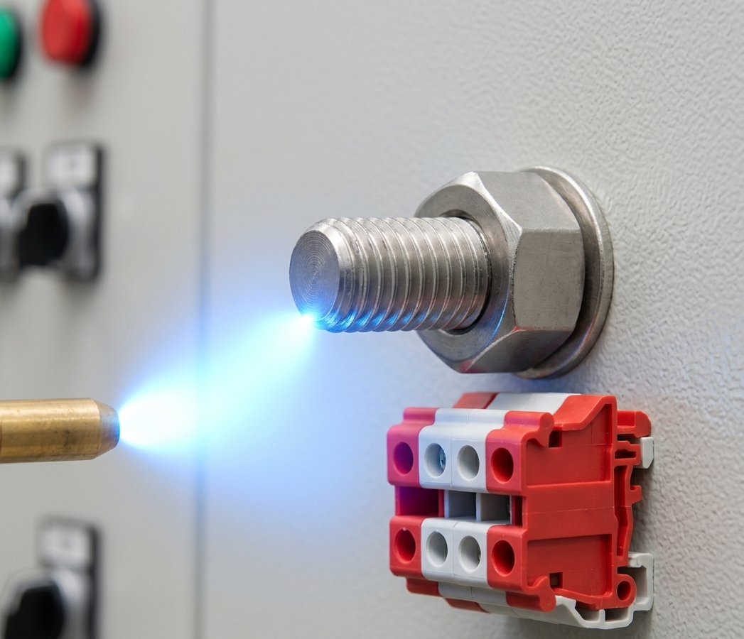
What is Arcing?
A phenomenon where electric current jumps across a gap between two conductors, turning the surrounding air into glowing plasma.
Burrs — Accidental Lightening Rods
A burr from machining, drilling, punching, or threading acts like a tiny lightning rod.
The tip of the burr — sometimes under 0.1 mm — concentrates the nearby electrical fields up to 100× more than a smooth surface, triggering arcing at normally safe voltages.
Deburring is not cosmetic: it is a direct arc-prevention measure.

Slide 4


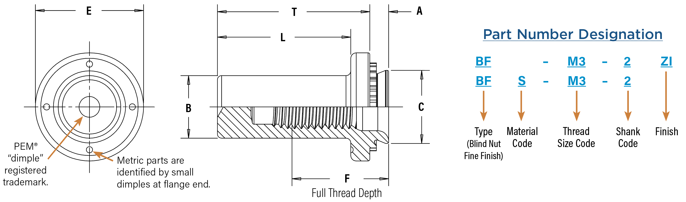

What are PEM® Fine Finish BF™/BFS™ Nuts?
Product Overview
Chip-Free Manufacturing Method
The PEM® Fine Finish BF™ (steel) and BFS™ (stainless steel) self-clinching blind nuts are purpose-built fasteners for copper and aluminum busbar applications and other electrical assemblies where proactive mitigation of burrs is desired.
Featuring an oversized flange and precision-finished geometry, these nuts press permanently into metal sheets as thin as 1.0 mm — with zero tolerance for metal chips or conductive debris.
PEM “Fine Finish” manufacturing methodology (denoted by “BF”) eliminates burrs and softens fastener features to mitigate the potential for discharge.
eMobility Ready
Engineered specifically for soft copper and aluminum busbars in EV and battery assemblies.
Large Flange Design
Greater bearing surface prevents deformation in soft materials while maintaining thread integrity.
Confidential 4
Notes:
The BF and BFS are the Fine Finish variants of PEM's proven B-series blind nuts. The key word here is 'fine finish' — the oversized holes and precision geometry are what differentiate these from the standard B line. Point out the part number structure so your customers and engineers know exactly how to order. BF is steel; BFS is stainless steel. The ZI suffix indicates zinc plating.

Slide 5
How BF™/BFS™ Nuts Differ from the Competition
Feature | PEM® B™/BS™ (Standard) | PEM® Fine Finish BF™/BFS™ (New) | Industry Standard Weld/Press Nuts
Fine finish manufacturing technique for burr-free part | ✗ | ✓ | ✗
Soft material performance | Standard | Superior (oversized mounting holes) | Poor in soft materials
Flange bearing surface | Standard | Large (improved thread retention) | Varies
Closed-end sealed threads | ✓ | ✓ | ✗ (open)
High-voltage safe (no conductive fines) | ✗ | ✓ | Depends
Minimum sheet thickness | .040” / 1mm | .040” / 1mm | Typically 1.5+ mm
Sizes available | #4-40 to 1/4-20 M3 to M8 | #4-40 to 1/4-20 M3 to M8 | Varies widely
Notes:
Walk your customers through this comparison carefully. The standard B-series works great for steel applications — but as soon as you're dealing with copper or aluminum busbars, EV assemblies, or any environment where conductive fines are a risk, the standard B falls short. The BF/BFS was built to solve exactly these problems. Weld nuts and press nuts can't match the cleanliness or sheet thinness capability. This table is your 'why upgrade' story.

Slide 6


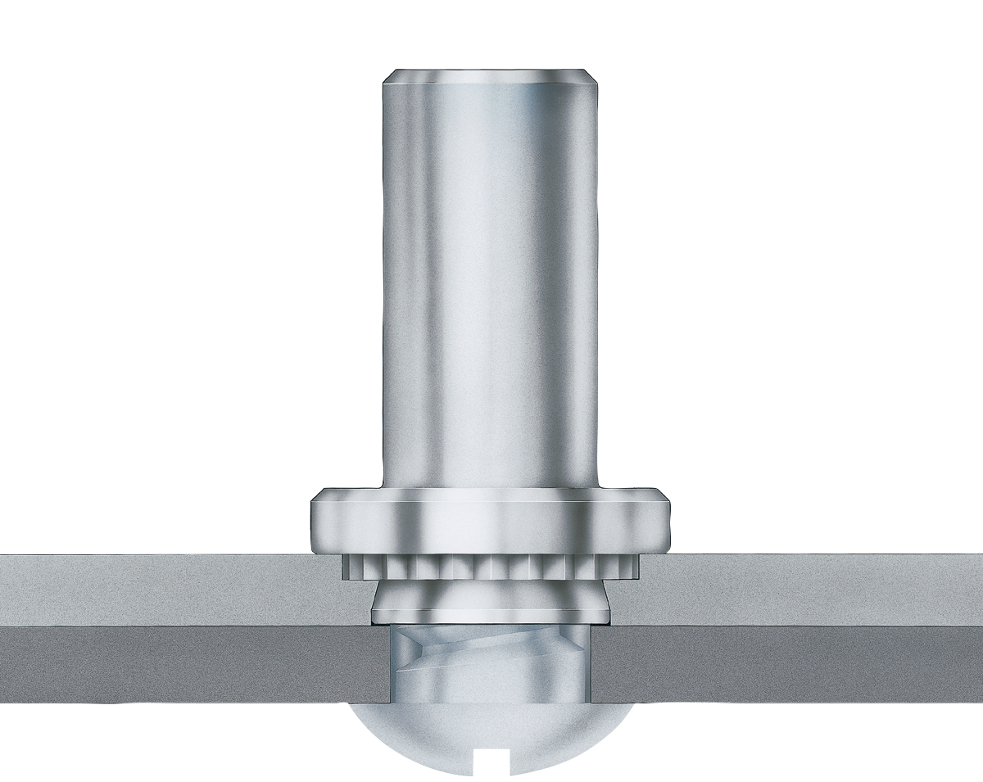


Applications where BF™/BFS™ wins
EV & eMobility
Battery packs, busbars, charging units, power electronics
Industrial Electronics
Power supply enclosures, switchgear, control panels
Datacom / Telecom
Aluminum or Copper Busbar
Server chassis, rack systems, network enclosures
Aerospace Electronics
Avionics bays, PCB assemblies, defense electronics
Notes:
The diagram shows a typical eMobility busbar assembly — one of the highest-priority applications for BF/BFS. When you visit EV customers, ask about their busbar assembly process. If they're using any fastener that creates chips during installation, you have a clear upgrade story. The four application segments on the right are your priority target markets. Datacom and Aerospace follow eMobility as highest-opportunity segments.

Slide 7
Installation – BF™/BFS™ Blind Nuts
Prepare properly sized hole in the panel per the datasheet dimensions. IMPORTANT: Do NOT deburr – no secondary operations required. Hole size: see BF/BFS size table for exact +0.8mm tolerance
Place the barrel of the fastener into the anvil hole and place the mounting hole (preferably the punch side) over the shank of the fastener. Shank acts as its own pilot – self-aligning design
With the installation punch and anvil surfaces parallel, apply squeezing force until the flange contacts the mounting sheet. The BF/BFS requires a HAEGER® or PEMSERTER® machine for best results. Verify complete installation by visual seating of the flange flush to the sheet
Thread Code | Anvil Dimensions (mm) | HAEGER® Part Number |  | PEMSERTER® Part Number
 | B (+0.1) | Anvil | Punch | Anvil | Punch
M3 | 4.67 | H-237-440L | H-103-00L | 8027364 | 975200048
M4 | 5.59 | H-237-832L | H-103-00L | 8027366 | 975200048
M5 | 7.67 | H-237-1032L | H-103-00L | 8027367 | 975200048
M6 | 9.17 | H-237-0420L | H-103-062L | 8027368 | 975200048
M8 | 11.79 | H-237-0518L | H-103-062L | 8027369 | 975200048
Also compatible with any standard press applying squeezing force between parallel surfaces.
Confidential 7
Notes:
The installation process for BF/BFS is nearly identical to the standard B-series — that's a key selling point for fabricators who already use PEM fasteners. The tooling table shows the exact HAEGER and PEMSERTER part numbers. Field engineers: bring this table to any installation discussion. Emphasize Step 1: NO deburring needed. This saves time and eliminates a process step in the customer's line.

Slide 8
Product Specifications
Metric | Thread Size x Pitch | Type/ Fastener Material |  | Thread Code (1) | Shank Code | A (Shank) Max | Min. Sheet Thickness | Hole Size in Sheet +0.08 | B Max. | C Max. | E ± 0.25 | F Min. | L Max. | T ± 0.25 | Min. Dist. Hole C/L to Edge (2)
 |  | Steel | Stainless Steel
 | M3 x 0.5 | BF | BFS | M3 | 1 | 0.97 | 1 | 5.41 | 4.6 | 5.38 | 7.95 | 7 | 9.8 | 11.2 | 6.9
 |  |  |  |  | 2 | 1.38 | 1.4
 | M4 x 0.7 | BF | BFS | M4 | 1 | 0.97 | 1 | 6.35 | 5.5 | 6.33 | 8.75 | 8 | 11 | 12.5 | 7.1
 |  |  |  |  | 2 | 1.38 | 1.4
 | M5 x 0.8 | BF | BFS | M5 | 1 | 0.97 | 1 | 8.75 | 7.6 | 8.73 | 11.1 | 10 | 14 | 16 | 8.6
 |  |  |  |  | 2 | 1.38 | 1.4
 | M6 x 1 | BF | BFS | M6 | 1 | 1.38 | 1.4 | 10.5 | 9.1 | 10.47 | 14 | 11.5 | 15.8 | 18.3 | 9.7
 |  |  |  |  | 2 | 2.21 | 2.29
 | M8 x 1.25 | BF | BFS | M8 | 2 | 2.21 | 2.29 | 12.7 | 11.7 | 12.67 | 16.35 | 13.5 | 19 | 22 | 13.5
(1) PEM® B™ and BS™ nuts are available on special order with a free-running locking thread feature allowing mating screw to turn freely until clamp
load is applied. For more information, contact PEM® Technical Support.
(2) For more information on proximity to bends and distance to other clinch hardware, see PEM® Tech Sheet C/L To Edge.
Confidential 8
Notes:
All BF and BFS sizes are metric only, ranging from M3 to M8. The minimum sheet thickness of 1.0 mm is a key spec to memorize — that's thinner than most alternatives. BF is carbon steel with zinc plating; BFS is 300-series stainless for corrosion-sensitive environments. The performance table on the right is especially useful when customers ask about pull-out and torque-out performance in aluminum — these numbers are strong.

Slide 9

Material and Finish Specifications
 | Threads | Fastener Materials |  | Standard Finishes |  | For Use in Sheet Hardness: (2)
Type | Internal, ASME B1.1, 2B / ASME B1.13M, 6H | Hardened Carbon Steel | 300 Series Stainless Steel | Passivated and/or Tested per ASTM A360 | Zinc Plated per ASTM B633, SCI (5um), Type III, Colorless (1) | HRB 80 / HB 150 or less | HRB 70 / HB 125 or less
BF | • | • |  |  | • | •
BFS | • |  | • | • |  |  | •
Part Number Code for Finishes |  |  |  | None | ZI
Confidential 9

Slide 10
Performance Data
Metric | Thread Size | Shank Code | Sheet Thickness (mm) | Test Sheet Material
 |  |  |  | 5052-H34 Aluminum |  |  | Cold-Rolled Steel
 |  |  |  | Installation (kN) | Pushout (N) | Torque-out (N•m) | Installation (kN) | Pushout (N) | Torque-out (N•m)
 | M3 | 1 | 1 | 8.9 | 470 | 1.13 | 12 | 645 | 1.7
 |  | 2 | 1.5 | 10 | 970 | 1.47 | 12 | 1250 | 2.03
 | M4 | 1 | 1 | 10 | 480 | 2.6 | 12 | 800 | 4
 |  | 2 | 1.5 | 12 | 845 | 4 | 20 | 1420 | 5.1
 | M5 | 1 | 1 | 10 | 750 | 3.6 | 18 | 900 | 4.5
 |  | 2 | 1.5 | 15.2 | 1580 | 5.7 | 24.5 | 1760 | 6.8
 | M6 | 1 | 1.5 | 17.8 | 1570 | 10.2 | 24.5 | 1870 | 17
 |  | 2 | 2.5 | 24 | 1570 | 14.1 | 31 | 1870 | 17
 | M8 | 2 | 2.5 | 26 | 1760 | 18.1 | 34 | 2020 | 20.3
NOTE: Published installation forces are for general reference. Actual set-up and confirmation of complete installation should be made by observing proper seating
of fastener as described in the installation steps. Other performance values reported are averages when all proper installation parameters and procedures
are followed. Variations in mounting hole size, sheet material, and installation procedure may affect performance. Performance testing this product in your
application is recommended. We will be happy to provide technical assistance and/or samples for this purpose.
Confidential 10

Slide 11

Where it is Easiest to Win
Start by understanding the risk. Ask: "How concerned is your team about arcing in this assembly?" Then ask: "What fastener solutions are you evaluating to address it?“
Once you've heard their answer, position the BF™ Series as a proactive risk-reduction solution — one that eliminates conductive debris at the source and delivers a larger bearing surface for the soft copper and aluminum common in eMobility assemblies.
EV / Busbar Design Reviews
Get in front of EV customers during design review — before they spec a fastener. BF/BFS eliminates contamination risk in one spec change.
High-Voltage Assembly Lines
Any facility handling busbars, capacitors, or battery packs needs chip-free assembly. BF/BFS is the only PEM solution purpose-built for this.
Confidential 11
Notes:
Your highest-value entry point is the design review — before the engineer has locked in a fastener. Once a fastener is spec'd and tooling is ordered, switching costs go up fast. If you can get a PEM FAE in front of an EV customer during the design phase, the BF™/BFS™ conversation becomes simple: one spec change eliminates a contamination risk they haven't fully solved yet. Ask your contacts when their next platform design review is scheduled and request a seat at the table.
For High-Voltage Assembly Lines
If a facility is already assembling busbars, battery packs, or capacitor banks, the pain is real and the urgency is high. Start by understanding the risk — ask: "How concerned is your team about arcing in this assembly?" Then ask: "What fastener solutions are you evaluating to address it?" Once you've heard their answer, position the BF™ Series as a proactive risk-reduction solution — one that eliminates conductive debris at the source and delivers a larger bearing surface for the soft copper and aluminum common in eMobility assemblies. Any facility that currently runs a manual chip-cleaning step after fastener installation is a warm lead — the BF™/BFS™ removes that process step entirely.
The common thread across both entry points: the customer already has the problem. You are not creating a need — you are showing up with the right answer at the right time.

Slide 12
Target Customer List – OEMs, ODMs, and Fabricators
eMobility & EV OEMs
Industrial & Commercial
Aerospace / Defense
BYD
NIO
Li Auto
CATL (battery systems)
Panasonic Energy Samsung
SDI
ABB
Siemens
Eaton
Rockwell Automation Emerson Electric
Schneider Electric Honeywell
Parker Hannifin Phoenix Contact Weidmüller
Raytheon (RTX) L3Harris
BAE Systems Northrop Grumman Lockheed Martin
Collins Aerospace
GE Aerospace Safran
Thales
Leonardo DRS
Tesla
GM (Ultium Platform)
Ford (BlueOval)
Rivian
Lucid Motors
BMW Group
Volkswagen Group
Hyundai/Kia
Stellantis
Charging Infrastructure
Datacom / Telecom OEMs
Contract Fabricators / ODMs
ChargePoint
ABB E-Mobility
Siemens eMobility Eaton (EV charging) Schneider Electric
Delta Electronics
BTC Power
Tritium
Blink Charging
EVgo
Cisco
Dell Technologies HPE
Juniper Networks Aruba (HPE)
Super Micro
Ericsson
Nokia
Huawei
ZTE
CommScope
Vertiv
Foxconn / Hon Hai Celestica
Benchmark Electronics
Creation Technologies
TTM Technologies
Jabil
Flex Ltd.
Sanmina
Plexus
IEC Electronics
Confidential 12
Notes:
This customer target list is organized by segment. Your first priority accounts should be any EV OEM or busbar assembly manufacturer in your territory. The charging infrastructure segment is the fastest-growing and often overlooked. Contract fabricators like Foxconn, Jabil, and Flex are multiplier accounts — winning one fabricator can unlock dozens of end OEMs. Reach out to your local PEM sales engineer for account assignments and any existing relationships.

Slide 13
Key Selling Points - Summary
Common Objections and Responses
Your BF™ / BFS™ Sales Story
Fine-finishing eliminates arcing risk in high-voltage assemblies
Oversized mounting hole delivers superior performance in soft copper and aluminum
Large flange bearing surface prevents deformation — no panel damage
Sames As Regular B-Nut Series:
Available in steel (BF) and stainless steel (BFS) for corrosion environments
Sealed closed-end protects against contamination and controls screw penetration depth
"We already use standard B nuts."
BF/BFS uses the same installation process — zero retraining. You gain contamination protection and soft-material performance at no operational cost.
"Our current fastener works fine.”
Ask: are you seeing any chip contamination, deformation in aluminum, or thread retention issues? The BF/BFS was designed to eliminate exactly those risks.
"We need custom sizes."
M3–M8 metric range covers most eMobility applications. Custom sizes available on special order — contact PEM Technical Support.

Slide 14
Availability
 | Kunshan | Danboro
P/N | Quantity | Quantity
BF-M3-2ZI | 24250 | —
BFS-M4-1 | 4615 | —
BF-M4-2ZI | 220 | —
BFS-M5-2 | 4380 | —
BF-M6-1ZI | 3740 | 3000
BF-M6-2ZI | 1710 | 3000
BF-M8-2ZI | 1980 | 2000

Slide 15
Call To Action
Your Next Steps Start Today
1
Identify 3 Target Accounts
2
Request Samples
Review your territory for existing B-series customers and eMobility OEMs/fabricators. Prioritize accounts with busbar or high-voltage assemblies.
Order BF/BFS samples through your PEM sales representative for customer demonstrations. Visit pemnet.com for datasheets and CAD files.
3
Schedule a PEM Virtual Consult
4
Talk to an Engineer
Connect with a PEM Field Application Engineer to prepare your customer pitch and application engineering support.
For technical questions, application support, or custom size inquiries — contact techsupport@pemnet.com or call 800-237-4736 (USA).
Confidential 15

Slide 16


Contact Information
Ross Zambanini
Director Market Expansion & Sales Excellence
RZambanini@pemnet.com
1-267-864-6530
Jay McKenna
Global Technical Marketing Manager
JMcKenna@pemnet.com
1-267-221-8147
Nick Marshall
Senior Engineering Manager Field App
NMarshall@pemnet.com
1-267-824-6935
Larry Zhang
Senior Applications Manager, Asia
LarryZhang@pemnet.com
+86 (512) 57269322

Slide 17
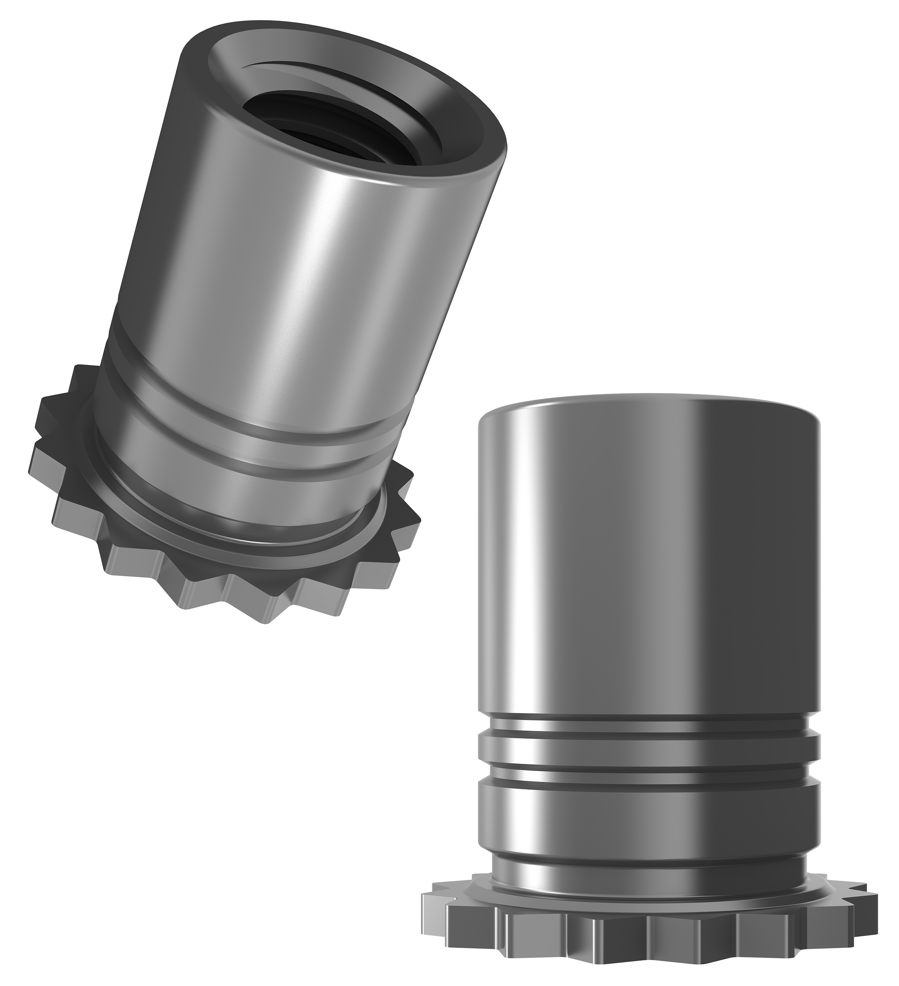
SOK™ and SOKS™ Knurled-Head Standoffs
The Edge-Distance Solution
New SOK™ and SOKS™ self clinching threaded standoffs for sheet metal, engineered where edge distance is tight
Knurled head design displaces less sheet material, enabling installation closer to panel edges than standard SO style standoffs
DSO stays in the catalog
Customers may keep ordering DSO or Y# parts, or move to SOK on their own timeline — SOK offers real savings
No forced transition: DSO removal is a future catalog decision; even then, existing DSO orders continue
New orders will naturally be channeled to the SOK part
Specifications for the SOK™ and SOKS™ standoffs can be found in the SO datasheet.
Closest-to-Edge Performance of DSO line Maintained
Min. hole C/L to edge of just .126" (3.2mm) vs .230” (6mm) with standard SO™ #4-40/M3
Notes:
SOK™ and SOKS™ are the newest members of the PEM® self-clinching standoff family. The core value proposition is simple: these are the only PEM® standoffs designed to install extremely close to the edge of a sheet metal panel. The knurled head design displaces far less material during installation than the standard hex head, which means we can get the hole center line within just 0.126 inches of the sheet edge. That's nearly half the clearance required by standard SO standoffs. And here's the sales win — customers don't need to buy new tooling. These install on the same HAEGER® and PEMSERTER® presses your customers already own.

